Slide 1

The Department of Information and Health Informatics (DATASUS) and the National Health Data Network (RNDS)
Coordination of Innovation and Health Informatics
CGIIS/DATASUS/SEIDIGI 05 June 2023

Slide 2
New Structure of the Ministry of Health 2023-2026
Ministry of Health
Minister's Office
Executive Secretariat
Secretariat of Primary Health Care
Secretariat of Health and Environmental Surveillance
Special Secretariat for Indigenous Care
Secretariat of Science, Technology, Innovation and the Health Economic-Industrial Complex
Secretariat for Management of Work and Education in Health
Secretariat of Information and Digital Health
Secretariat of Specialized Health Care
SAES
SVSA
SESAI
SGTES
SEIDIGI
SAPS
SECTICS

Slide 3
Ana Estela Haddad
Secretary of Information and Digital Health
Sérgio Rosa
Director Datasus
Paulo Sellera
Director DEMAS
Cleinaldo de Almeida
Director DESD
General Coordination of Architecture, Product and Information and Communication Technology Solutions (CGAPSTIC)
General Coordination of Innovation and Health Informatics (CGIIS)
General Coordination of Relationship, Governance and Projects (CGRGP)
General Coordination of Infrastructure and Information Security (CGIE)
General Coordination of Relationships with Federal Hospitals (CGRHF)
General Coordination of Dissemination and Integration of Health Data and Health Information (CGDID)
General Coordination of Monitoring and Evaluation (CGMA)
General Coordination of Strategic Health Information Management (CGGIE)
General Coordination of Telehealth (CGTS)
General Coordination of Innovation in Digital Health (CGPIN)

Slide 4
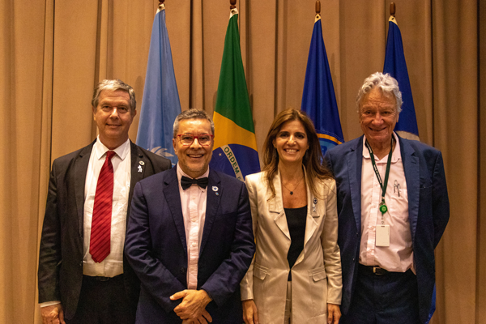
SUS and Health Information
The Health sector is fundamental for the national development. The information generated by the Unified Health System has an enormous potential to generate new knowledge, services and products, in meeting the demands of society.
Brazil has an information infrastructure that must be understood as a National Heritage in the defense and promotion of life and well-being.
The Department of Information and Informatics of the Unified Health System (DATASUS/SEIDIGI), in almost 35 years of activity, has developed around 200 systems that directly support the Ministry of Health in the process of building and strengthening the SUS.

Slide 5
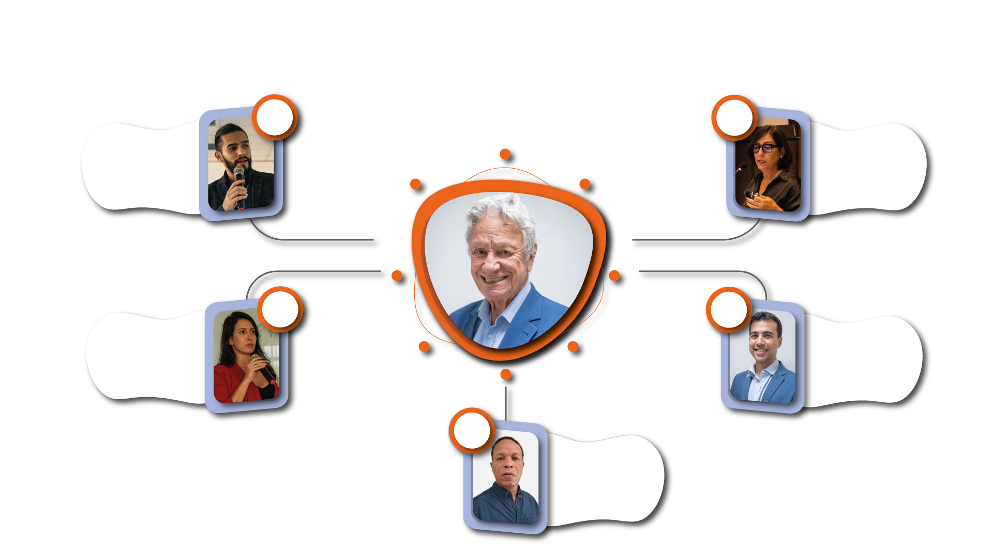





DATASUS Chart
CGIE
CGIIS
Marcos Milanez
Paula Xavier
General-Coordinator
General-Coordinator
CGRGP
Sérgio Rosa
CGAPSTIC
Jackeline Almeida
Director
Frank Pires
General-Coordinator
General-Coordinator
CGIE - General Coordination of Infrastructure and Information Security
CGRGP - General Coordination of Relationship, Governance and Projects
CGIIS - General Coordination of Innovation and Health Informatics
CGRHF- General Coordination of Relationships with Federal Hospitals
CGAPSTIC - General Coordination of Architecture, Product and Information and Communication Technology Solutions
CGRHF
Jorge Gonzaga
General-Coordinator

Slide 6



The Citizen is the Protagonist in the implementation of Digital Health in Brazil
DIGITAL HEALTH STRATEGY FOR BRAZIL 2020-2028:
Access to information, continuity of care and strengthening of clinical decision support, surveillance and regulation in health.
New National Policy on Health Information and Informatics (PNIIS) was updated, with public consultation and approved by social control. The instruments agreed upon in CIT recognize the RNDS as a platform for interoperability in health.

Slide 7
By 2028, RNDS will be established and recognized as the digital platform for innovation, information and healthcare services for all Brazil, for the benefit of users, citizens, patients, communities, managers, healthcare professionals and healthcare organizations.
DIGITAL HEALTH STRATEGY FOR BRAZIL 2020-2028

Slide 8
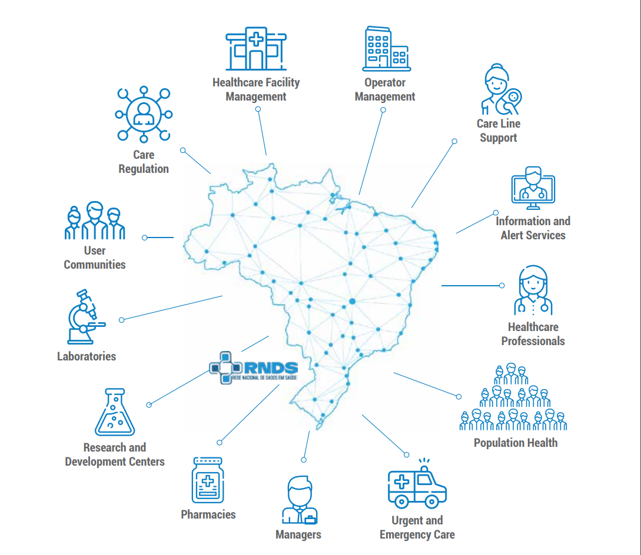
RNDS
RNDS is a platform that connects different health information systems, integrating data from States and Municipalities at the national level
Therefore, it provides continuity of health care

Slide 9

RNDS IN NUMBERS
538.2
million
4,012
70.2 million
Basic Health Units integrated to the RNDS via PEC e-SUS APS
Covid-19 vaccination records sent to RNDS
Examination Records at the RNDS.
+
844.8
million
+686
Laboratories qualified to send exams to RNDS (308 sending)
Routine vaccine records.
Jun/2023
=
+1.38 BILLON
records

Slide 10
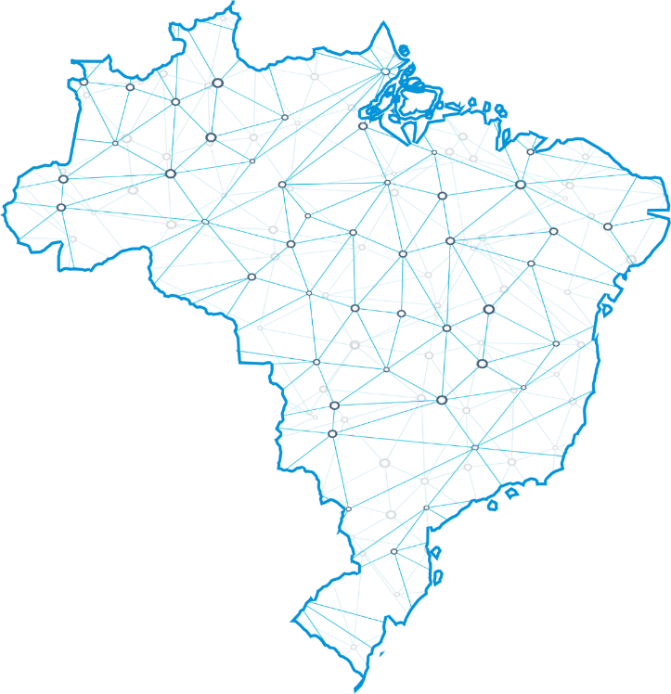

How does data transit in the RNDS?
Informational Model
01
Conceptual representation in sections and given blocks;
Crafted from expert knowledge;
Computational Model
02
Implementation of standards according to MI;
RNDS – HL7/FHIR;

Slide 11





THE PROCESS
Systems / Platforms
Informational Model
Computational
Model
Interoperability
Health establishments use different Information Systems in the management of demands, users and professionals.
Conceptual representation, in which elements are modeled in sections and blocks of data.
Different information systems (MoH or not) interact with the RNDS and share information
Defining and implementing features that customize the FHIR standard in the national context

Slide 12
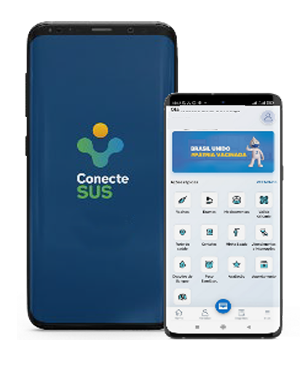
With access to clinical history, scheduling appointments, hospitalizations, vaccines, test results, regulatory transparency and various SUS services.
Conecte SUS Citizen
+ 170 Million
of citizens able to access
+ 39 Million
It is health in the palm of the citizen's hand
of app downloads
+ 33 Million
of issued Covid-19 certificates
National Digital Vaccination Card;
National Certificate of Vaccination Covid-19;
Equivalence with the European Union;
International Certificate of Yellow Fever Vaccination (CIVP);
Medications from the Popular Pharmacy Program

Slide 13

Development flow
Health Business
Demands
Modeling Process
Necessities
Business Analysis
Systems Analysis
Production Implementation
Implantation
Opportunities
Systems
Services
National Repository of Health Knowledge Artifacts
Terminology Standards and Interoperability Features
Data element
Standards
RTS Concepts Element

Slide 14
INFORMATION MODELS IN THE RNDS
REL
Laboratory Examination Record
Portaria SAES 1.068/2020
Portaria GM 3.328/2022
RIA
Administered Immunobiological Record
CMD*
Minimum Data Set
In production
Resolução CIT nº 06 de 2016 e alterado pela Resolução CIT nº 34 de 2017
RDM
Medication Dispensing Record
Portaria SAES 50/2022
RAC*
Clinical Care Record
Portaria SAES 234/2022
RPM*
Medication Prescription Record
Portaria SAES 50/2022
In homologation
RIRA
Care Regulation Information Record
SA
Discharge Summary
Portaria SAES 701/2022
SAO
Obstetric Discharge Summary
In development
RPS
Personal Health Record
RID
Diagnostic Image Registration
Foreseen
* Going through adjustments.

Slide 15
Brazilian IPS

Slide 16
Brazil IPS premisses
Data currently available on RNDS will be used to generate the first version of Brazil IPS;
More than 1.2 billion immunization records of 103 different vaccines (at least 4 of them do not exist on SNOMED core…);
More than 800.000 Lab reports of COVID-19 and Monkeypox exams;
It is expected that till October we will also have allergies and medications from eSUS-AB - the Brazilian primary care information system used in 82% of our primary care units.

Slide 17
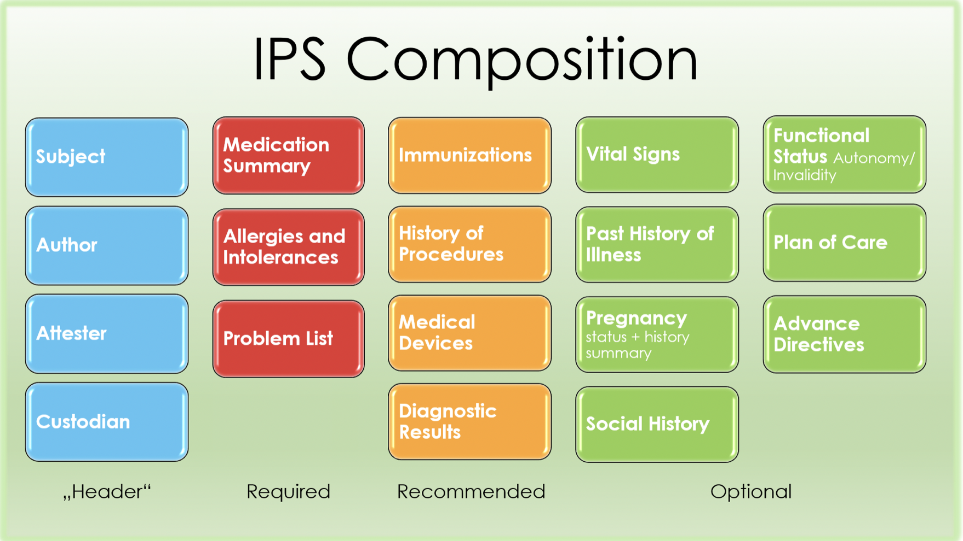
http://hl7.org/fhir/uv/ips/

Slide 18
Current Status IPS-Brasil
80% of the Brazilian RNDS CodeSystems, ValueSets and ConceptMaps of Immunization (IPS), Diagnostic Report (IPS), Allergy Intolerance (IPS), and Medication (IPS) loaded in OCL terminology server;
20% of the FHIR IPS profiles in FHIRSH for those sections that will be in the first version of the Brazilian IPS - Immunization (IPS), Diagnostic Report (IPS), Allergy Intolerance (IPS), and Medication (IPS);

Slide 19
seidigi@saude.gov.br
+55 (61) 3315-3574/3286

